Slide 1
Cambridge Surprise Minor

Slide 2
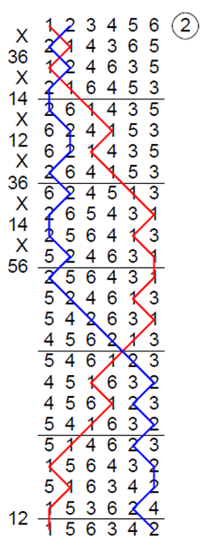
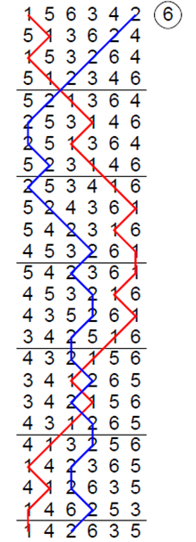
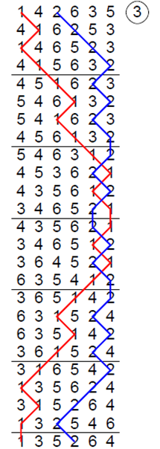
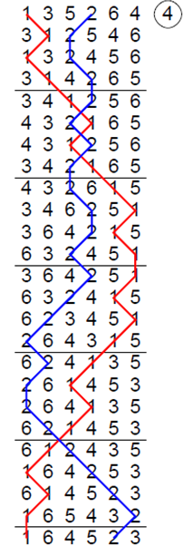
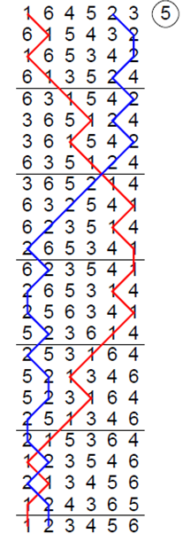
Cambridge Surprise Minor

Slide 3
Cambridge Surprise Minor

Slide 4
Cambridge Surprise Minor

Slide 5
Cambridge Surprise Minor

Slide 6
Cambridge Surprise Minor

Slide 7
Cambridge Surprise Minor

Slide 8
Cambridge Surprise Minor

Slide 9
Cambridge Surprise Minor

Slide 10
Cambridge Surprise Minor

Slide 11
Cambridge Surprise Minor

Slide 12
Cambridge Surprise Minor

Slide 13
Cambridge Surprise Minor

Slide 14
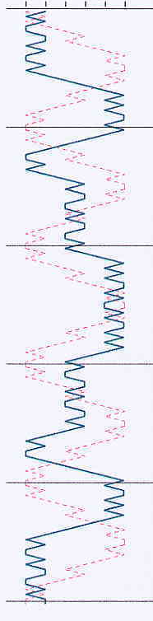
Symmetry

Slide 15
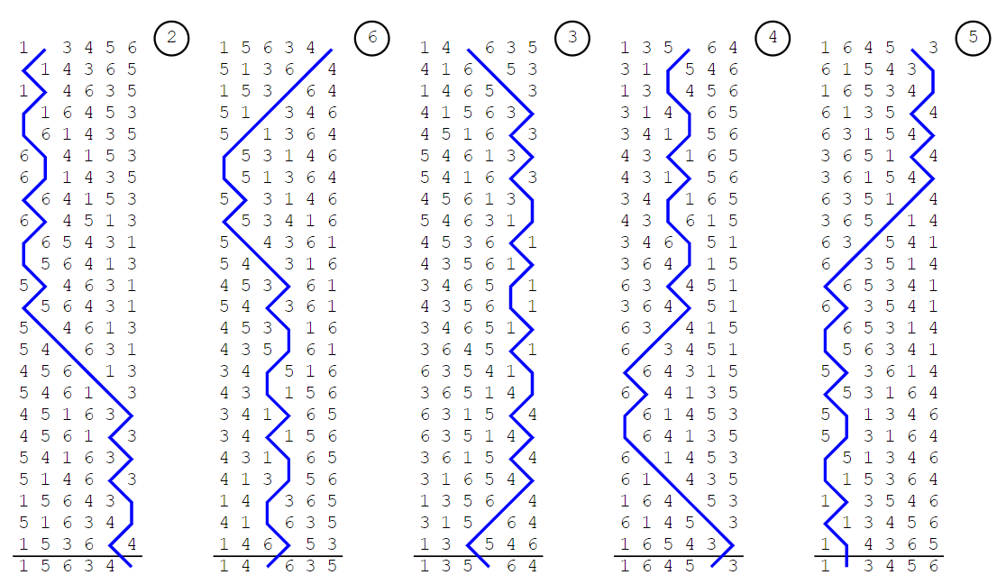
Symmetry

Slide 16
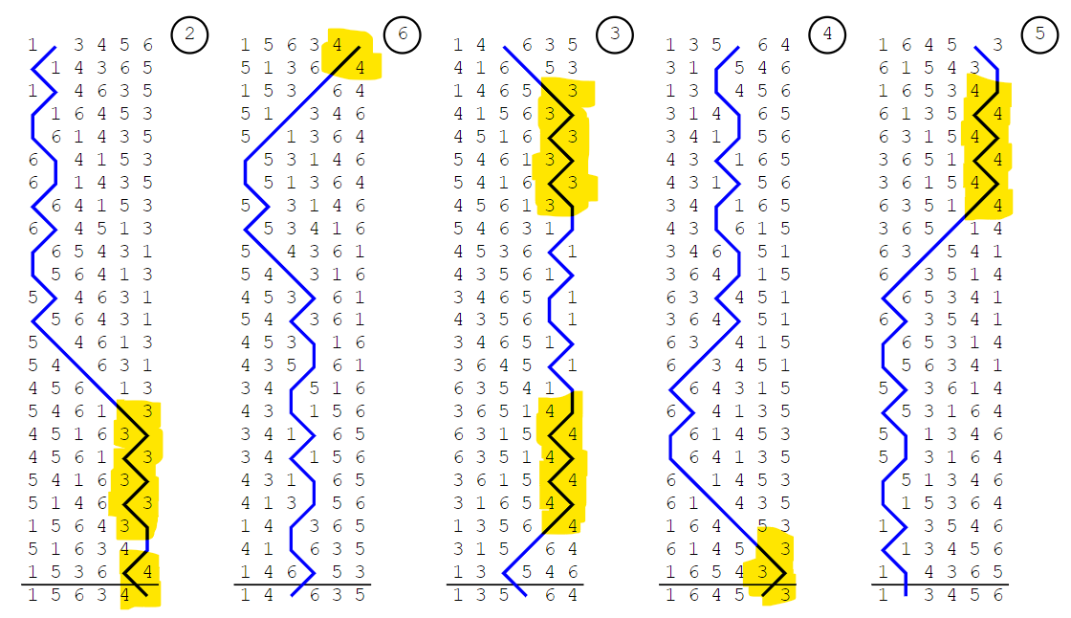
Course Bells
Notes:
Always dodge with 3 & 4 at back unless treble
Course bells from plain hunt
One less thing to remember
Only changes at a bob/single

Slide 17
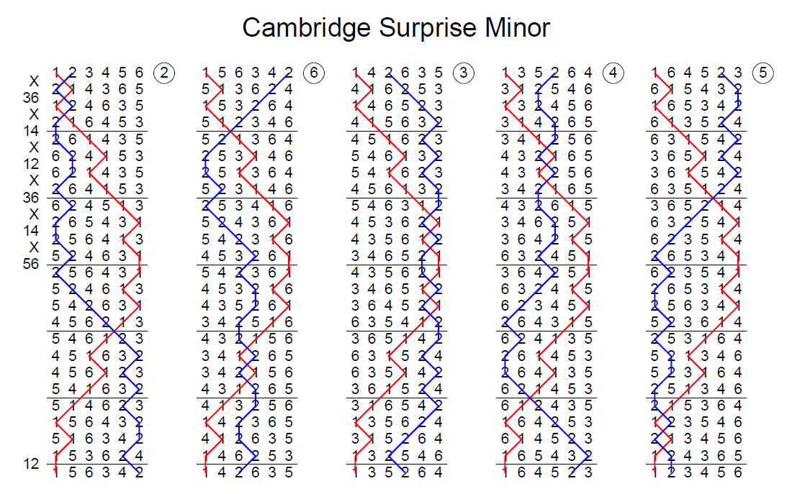
Place Bells
Notes:
Split method into place bells
Be able to recall each place bell
Helps to be kept right, allows for splicing

Slide 18
Place Bell Order
2^{nds}
6^{ths}
3^{rds}
4^{ths}
5^{ths}
Notes:
Remember it
Different for different methods, but fairly short number of possibilities

Slide 19
Terminology
Rounds
Place Bell
Cambridge Frontwork
Half Lead
Lead End
Rounds
Cambridge Places or 3/4 Places

